Slide 1

Prevalence Spatial Analysis of Cancer Data -2019
Sonu Gupta
Deepak Kumar
Atul Verma

Slide 2
PURPOSE OF THE DATA-
To examine the spatial prevalence of cancer-related to tobacco and alcohol among male and female populations across different regions within Indian states.
DATA DESCRIPTION-
There are 36 states/UTs and 10 columns including states/UTs
Here is a description for each column in your dataset:
States/UTs: Name of the states and union territories in India.
total cases: Total number of cancer cases in the respective state or union territory.
Alcohol male: Ratio of male cases attributable to alcohol consumption.
Alcohol women: Ratio of women cases attributable to alcohol consumption.
tobacco male: Ratio of male cases attributable to tobacco consumption.
6. tobacco women: Ratio of women cases attributable to tobacco consumption.
7. Projected Population: The estimated total population of the respective state or union territory. 8. Projected Population Male: Estimated male population of the respective state or union territory. 9. Projected Population Female: Estimated female population of the respective state or union territory.
10. Prevalence: Prevalence rate of cancer cases in the respective state or union territory.

Slide 3
SOURCE OF THE DATA-
We obtained a dataset for the total number of cancer cases in each of the 36 states/UTs from the Indian Government site https://www.indiastat.com/table/health/state-wise-estimated-number-cancer-cases-india200/627134
Then, we extracted data for the following variables from the government site https://rchiips.org/nfhs/factsheet_NFHS-5.shtml
for each of the 36 states/UTs: 'Alcohol male', 'Alcohol women', 'tobacco male’, 'tobacco women', 'Projected Population', 'Projected Population male', 'Projected Population female’.
Finally, we merged these datasets to create a comprehensive dataset for the 36 states/UTs, now containing 10 columns.

Slide 4
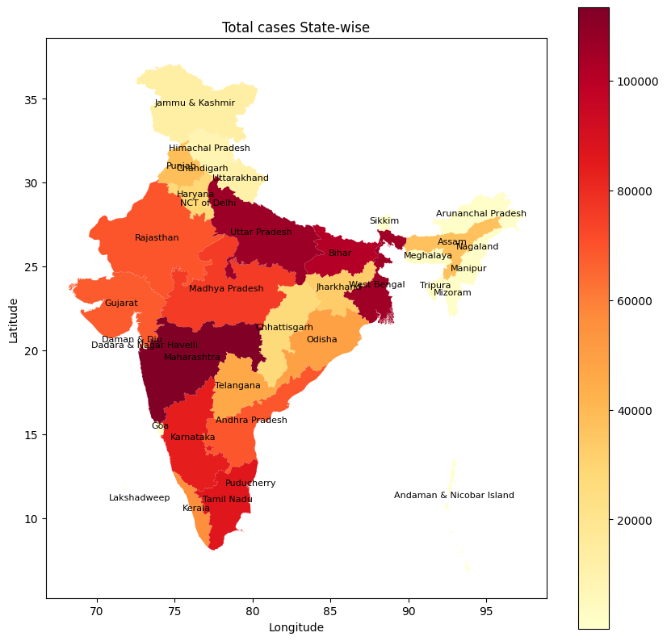
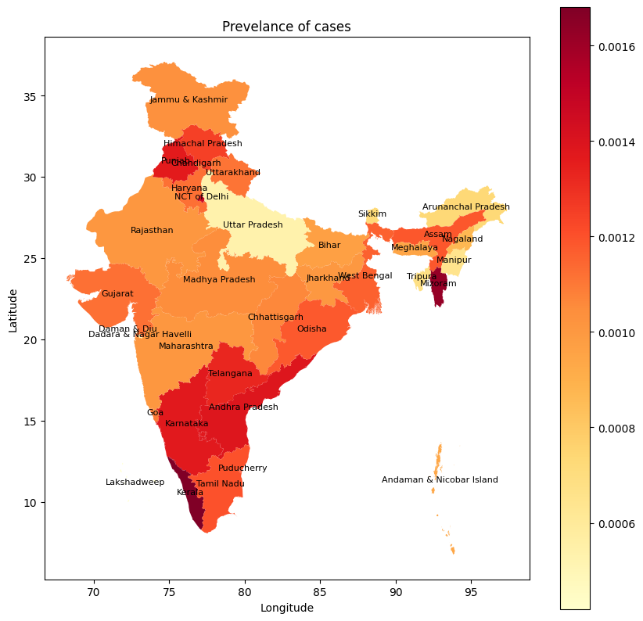
Spatial Analysis
Interpretation:
The total number of cancer cases in each state alone cannot determine which state has the highest number of cases, as it is influenced by the population density. Therefore, prevalence is utilized to compare cancer cases across states.

Slide 5
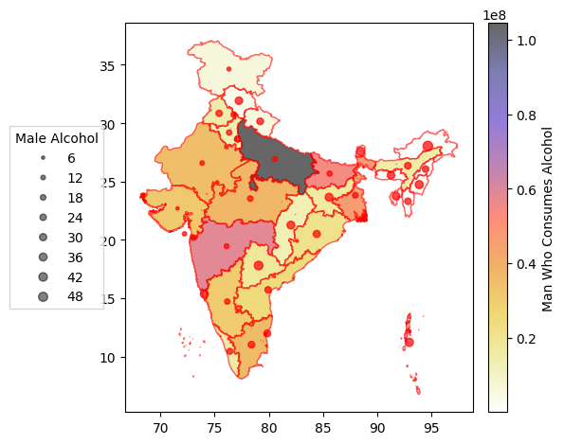
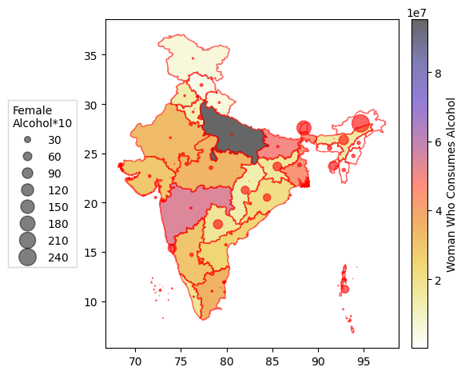
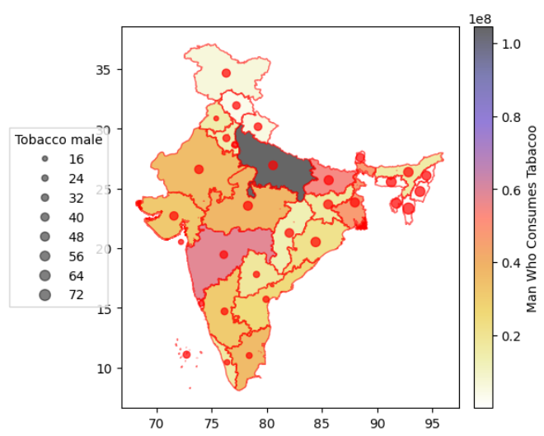
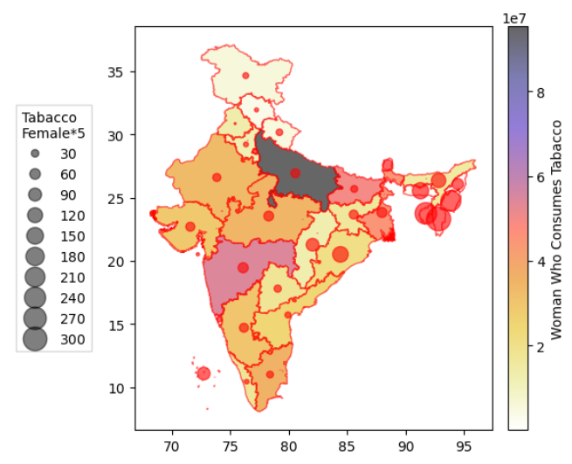
Alcohol and Tobacco in Men vs Women
Interpretation:
In Uttar Pradesh, Maharashtra, Bihar, and West Bengal, high populations do not correspond to high alcohol-related consumption ratios.
Seven Sister states, Telangana, Chhattisgarh, and others exhibit elevated male alcohol consumption. Sikkim shows high male and female alcohol consumption, while Assam, Tripura, and others have notable female alcohol consumption ratios.
Interpretation:
Among men, higher tobacco prevalence is seen in Central India, Seven Sisters states, West India, North India, and Lakshadweep.
Even in regions like the Seven Sisters states with lower male populations, significant tobacco use persists. Among women, prominent tobacco consumption is observed in Seven Sisters states, Odisha, Chhattisgarh, Lakshadweep, and Maharashtra, with notably higher prevalence than men in certain areas like the Seven Sisters states and Maharashtra.
North India shows lower alcohol consumption rates among women compared to other regions.

Slide 6
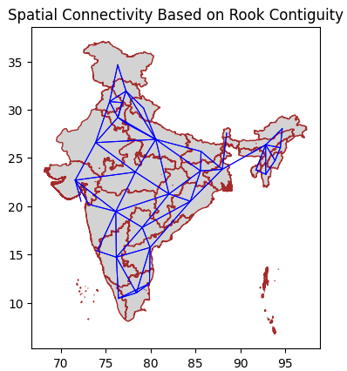
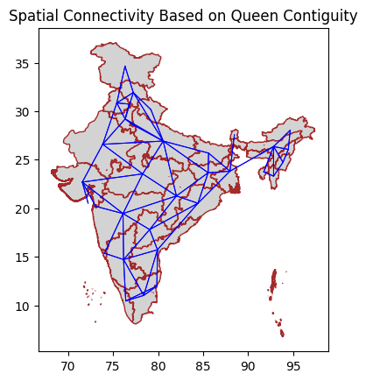
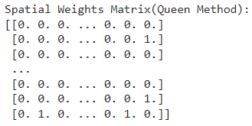
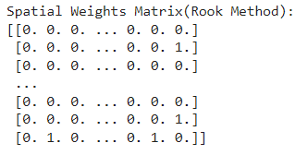
Weight Matrix Rook and Queen:
INTERPRETATION:
As we can see UP has 7 connections which is the highest compared to other states.
Regions are connected based on the Rook/Queen contiguity method, sharing borders or corners.
Gray shapes with brown borders represent individual regions.
Spatial weights matrix by both Queen and Rook methods giving same weighted matrix.

Slide 7
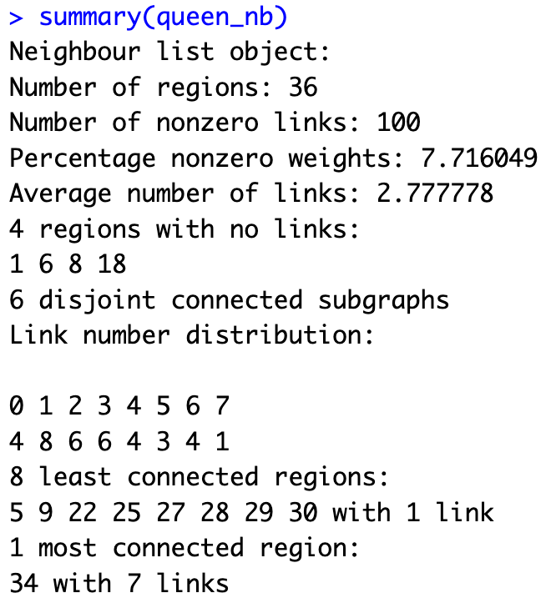
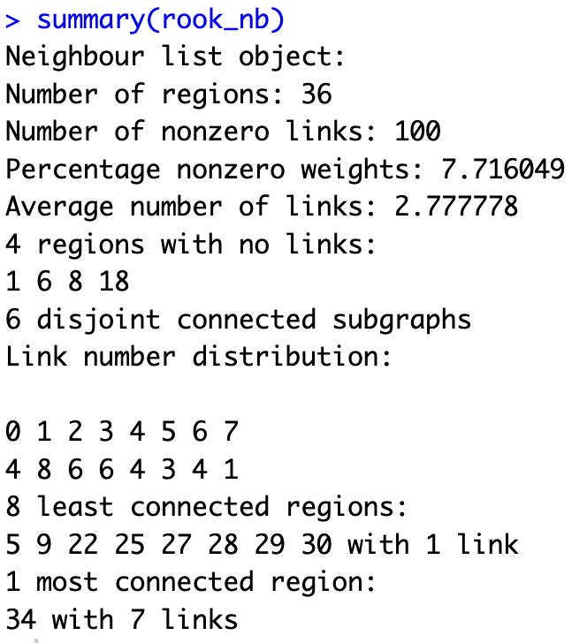
Summary of Rook and Queen Contiguity Spatial Weights Matrix
The Rook contiguity spatial weights matrix provides valuable insights into the spatial relationships among the regions considered in the analysis. Here's a breakdown of the key findings:
Neighbour List Object:
- Number of Regions: 36
- Number of Nonzero Links: 100
- Percentage Nonzero Weights: 7.72%
- Average Number of Links: 2.78
Regions with No Links:
- There are 4 regions (indexed 1, 6, 8, and 18) that have no connections with any other region.
Disjoint Connected Subgraphs:
- The spatial connectivity forms 6 disjoint connected subgraphs, indicating separate clusters or groups of regions with no connections between them.
Link Number Distribution:
- The distribution of link numbers across regions reveals:
- 4 regions have 0 links
- 8 regions have 1 link
- 6 regions have 2 links
- 6 regions have 3 links
- 4 regions have 4 links
- 3 regions have 5 links
- 4 regions have 6 links
- 1 region has 7 links
Least Connected Regions:
- The 8 least connected regions (indexed 5, 9, 22, 25, 27, 28, 29, and 30) each have only 1 link.
Most Connected Region:
- Region 34 stands out as the most connected region with 7 links, indicating strong spatial connectivity with neighboring regions.
This summary provides a comprehensive overview of the spatial relationships among the regions based on the Rook contiguity spatial weights matrix. It highlights the distribution of connections, identifies isolated regions, and characterizes the connectivity patterns across the geographic area under study.

Slide 8
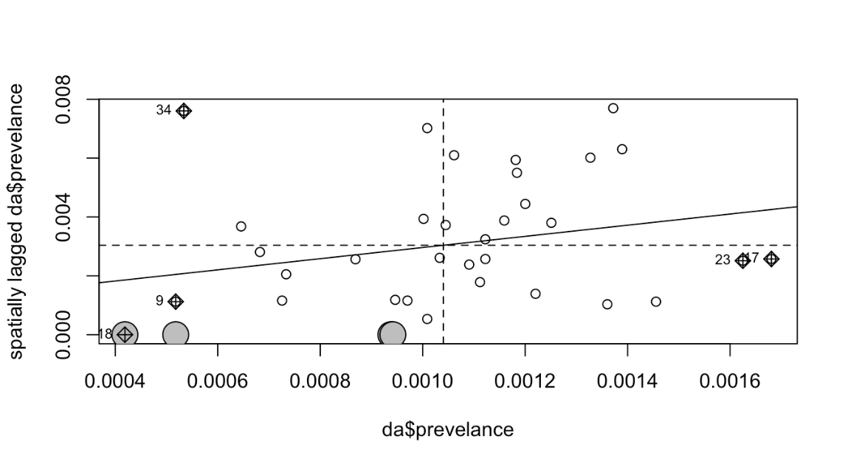
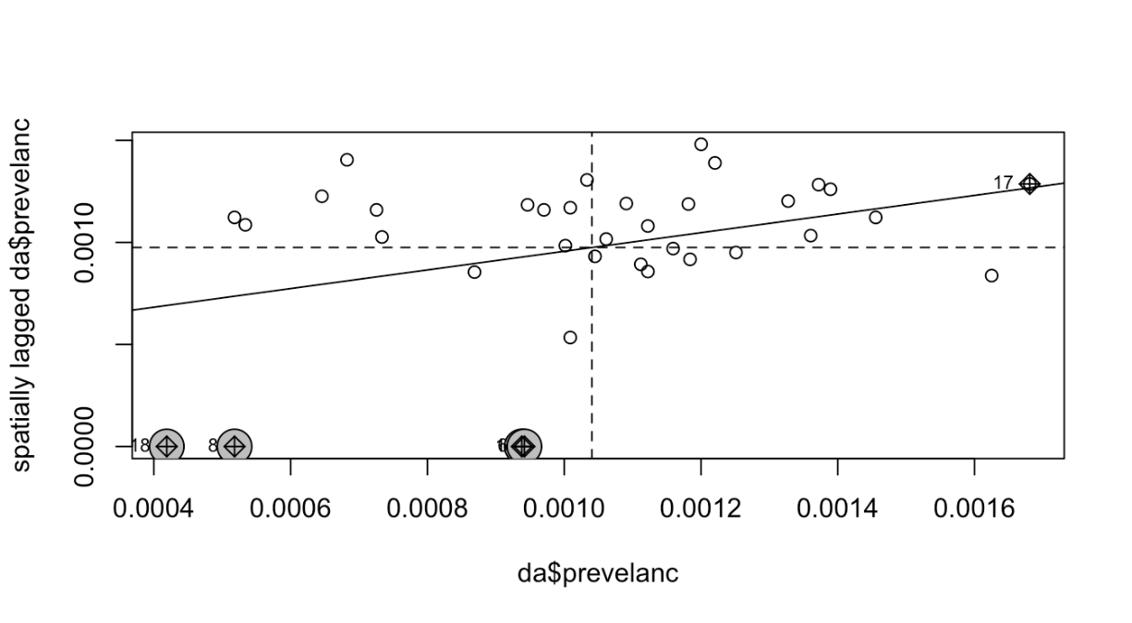
Global measures of spatial auto-correlation:
 | Moran’s I | Geary’s C
Binary Weights (Non-standardized weight matrix) | I:0.05523753 E(I): -0.03225806 Var(I): 0.01668141 p-value: 0.2491 | C: 0.067290737 E(C): 1 Var(C): 0.03274595 p-value: 0.3534
Standardized weight matrix | I: 0.02668152 E(I): -0.03225806 Var(I): 0.02218787 P-value: 0.3462 | C: 0.072989633 E(C): 1 Var(C): 0.02634209 P-value: 0.4804
Interpretation:
Based on the p-values obtained from both tests in both cases, we can conclude that our data does not provide sufficient evidence of spatial autocorrelation.
In the case of Moran's I statistic, the value of I is slightly greater than 0, suggesting a mild positive spatial autocorrelation among the regions. Similarly, in the case of Geary's C statistic, the value of C is smaller than 1, further indicating the presence of a very mild positive spatial autocorrelation among the regions.

Slide 9
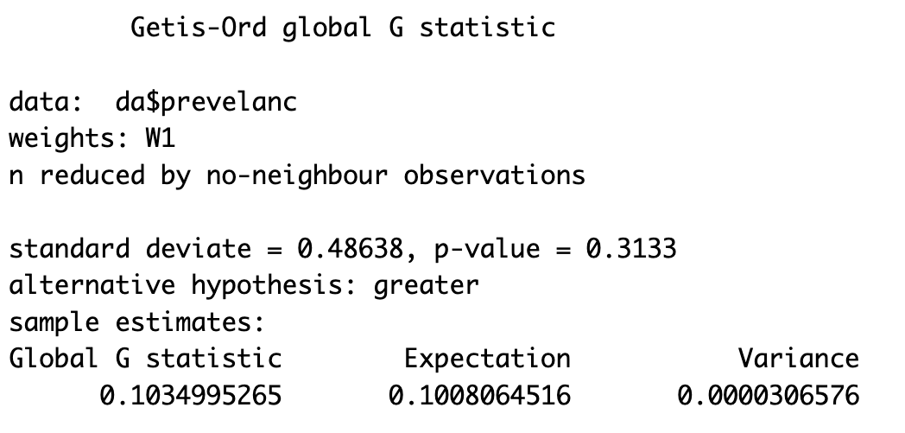
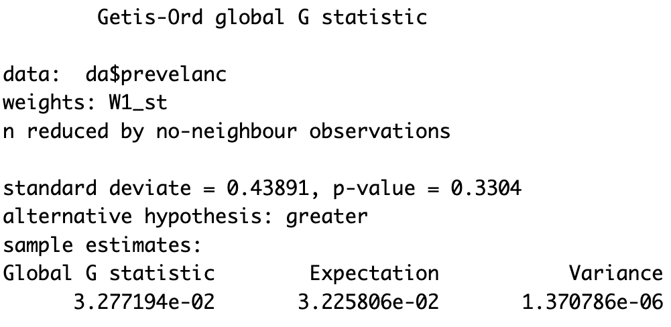
Getis-Ord G statistic
1. Binary weights:
2. Standardized weight
Summary:
We can see that the Global G statistic is greater than it's expected value indicating potential hotspots.
The p-value is large to 0.05 and statistically insignificant. So, the null hypothesis fail to rejected.
The z-score value is positive, the observed General G index is larger than the expected General G index, indicating that high values for the attribute are clustered in the study area.

Slide 10
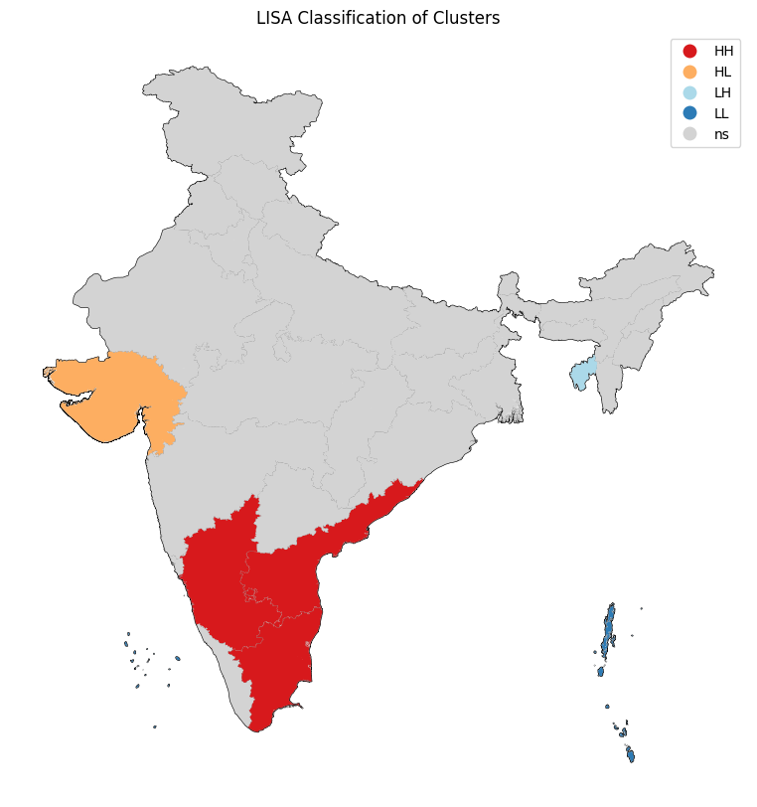
Local Measures of Spatial Auto-correlation:
Interpretation of LISA:
Regions with intense coloring contribute significantly to a positive global spatial autocorrelation result, whereas lighter colors contribute significantly to a negative spatial autocorrelation result.
A region where high values cluster together is referred to as a hot spot, while a region where low values cluster together is called a cold spot.

Slide 11
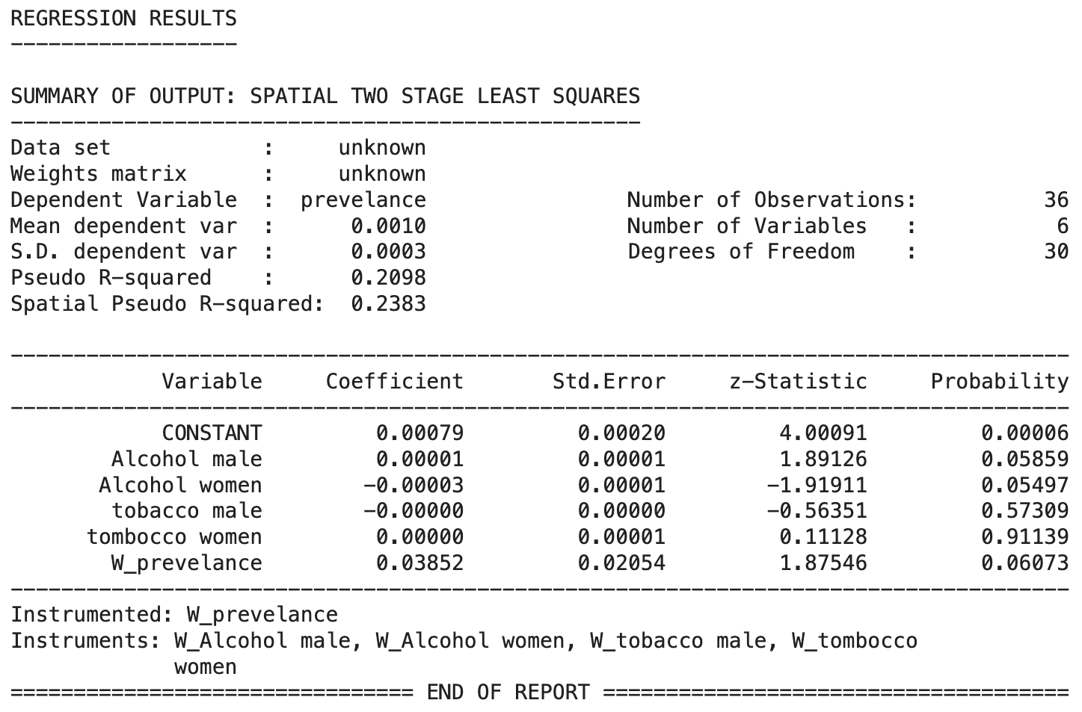
Spatial Models: Spatial Lag Model
Interpretation:
We can see that the value of rho is positive. Here rho = 0.03852 > 0 but very near to zero which implies that there is a positive small spatial dependence.
Also the p-value (0.06073) for the rho is coming out to be insignificant (greater than 0.05).
The pseudo-R-squared values indicate moderate model fit, with 20.98% of the variance explained and 23.83% when accounting for spatial effects.

Slide 12
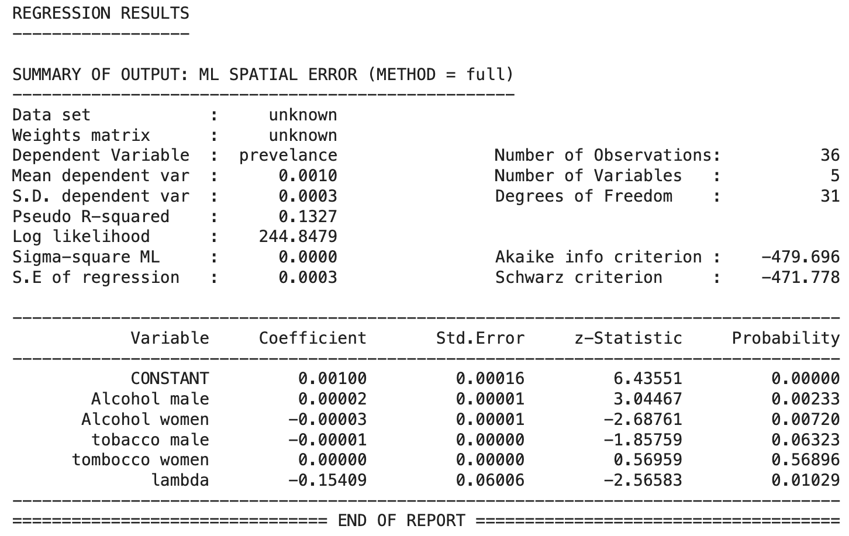
Spatial Models: Spatial Error Model
Interpretation:
We can see that lambda is negative. The negative value of lambda implies negative spatial correlation, i.e., clustering of opposite values (high with low and low with high).
Also the p-value for lambda is less than 0.05. The statistical significance of lambda provides evidence of the presence of spatial effects among the error terms.
In this model, the alcohol male column is significant. Since the p-value is less than 0.05.

Slide 13
THANK YOU

